Slide 1
IBM Security ReaQta
Essential MDR
—
First Lastname
Job Title

Slide 2
Endpoint security: more timely, more challenges
Traditional approaches rely on finding what’s known (known signatures), but attackers target unknown (fileless/ransomware)
Poor visibility and zero-day attacks
Attackers are “living off the land” (manipulating legitimate software and files to disguise their presence)
A rise in—and complexity of—malicious and automated cyber activity, most of which originates at the endpoint
Inexperienced, new and fatigued analysts who struggle with complex tooling, alert overload and time-consuming investigations
“Endpoint security continues to be one of the most requested core topic coverage areas ... because the endpoint is often a target of attack, attacks becoming more sophisticated, and endpoints getting more and more diversified.”
Gartner, Guide to Endpoint Security Concepts, Dec. 2020
Notes:
As Gartner noted, “endpoint are often a target of attack, attacks becoming more sophisticated, and endpoints getting more diversified.”
Some of the major challenges include … [on slide]

Slide 3

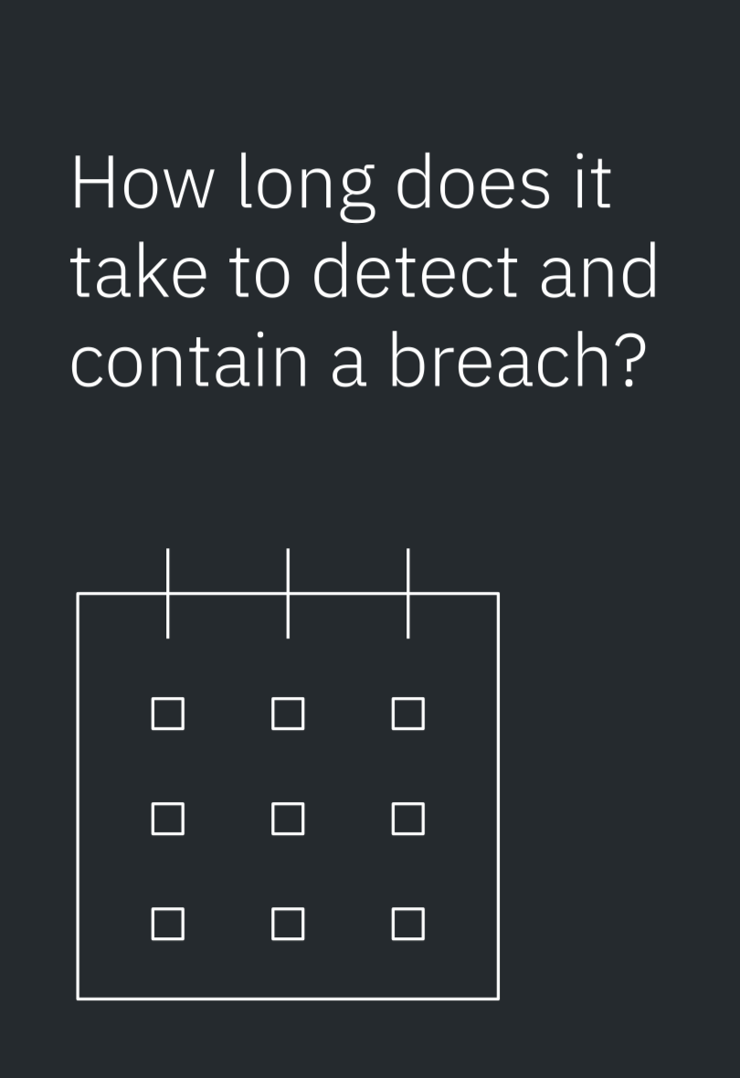
Average number of days in a lifecycle of a compromised credentials attack breach
341
287
Average number of days to identify and contain a breach
$1.26
A breach lifecycle under 200 days costs $1.26 million less than a lifecycle over 200 days
IBM Security © 2022 IBM Corporation
2021 Cost of a Data Breach Report
Notes:
If endpoint security isn’t prioritized, here’s the potential impact a breach may have on your business.
2021 Cost of a Data Breach Report: https://www.ibm.com/downloads/cas/OJDVQGRY

Slide 4

Is MDR right for you?
Common pain points
Too many tools and alerts to adequately reduce mean time to resolution (MTTR) and improve productivity
Cybersecurity skills gaps are increasing with lack of experienced security professionals to handle sophisticated and advanced threats
Meeting compliance and regulatory requirements - regulations aren’t just for the financial services and healthcare industries
Lack of visibility into your environment
Notes:
40% percent of midsize businesses say they will use MDR as their only managed security service by 2024. [Gartner’s 2019 Market Guide to Managed Detection and Response]
To know if it’s right for you, here are some common pain points [on slide]. You should also ask yourself these questions:
What percentage of time does your team spend responding to security incidents?
How effectively does your organization currently detect and contain potential threats?
How do you detect and remove zero-day threats from your environment?
How do you detect the TTPs threat actors are known to use against companies in your industry and geography?
If you were attacked today, do you have the visibility required in your environment to identify and contain it?

Slide 5




Essential MDR for IBM Security ReaQta
AI-powered, managed endpoint detection & response with 24/7 monitoring, alert enrichment
24/7/365 monitoring
Today’s cyber threats require a complete understanding of your environment in order to detect the most minute anomalies. We provide 24/7 monitoring, tracking and resolve critical alerts while keeping you always up to date.
Zero downtime
We contain and remediate threats as soon as they’re detected - minimizing your business risk and reducing damages and interruption of services.
AI-powered cyber defense
With both artificial intelligence and our team’s deep experience in intelligence and analysis, we help you to identify and track even the most sophisticated actors and run advanced threat hunting campaigns.
Deep threat portfolio
We can extend your protection and recovery through our extensive catalogue (Advisory, Systems Integration, Managed Security Services).
Notes:
Essential MDR for IBM Security ReaQta is for mid market clients who could benefit from an AI-powered, reasonably priced, managed endpoint detection and response solution. We will provide the key capabilities outlined on this slide to include 24/7/365 monitoring, AI-powered intelligence, SaaS offering reducing the risk of downtime, as well as offering customers other MSS services.
Security teams are facing an ever-increasing barrage of threats – from ransomware to business email compromise to nation state attacks.
At the same time, they are tasked with supporting new business initiatives, securely enabling cloud migrations, and complying with an evolving regulatory landscape.
Today security should be flexible, scalable, modern, and intuitive to help quickly and easily defend against advanced threats, proactively hunt for stealthy attackers, and address regulations.
Traditional cybersecurity programs are challenged with handing this level of transformation due to today’s security realities.
At the same time, the migration to cloud has expanded the attack surface and created the need for more security controls. An increase in the volume and sophistication of threats only exacerbates the challenges of today’s security operations centers (SOCs). Disjointed data and lack of visibility can leave security teams with blind spots to the next potential threat.
As IT environments grow more and more complex, organizations may have to consider modernizing their security operations.
The current approach to threat detection and response appears unsustainable.
Point solutions meet a distinct need but isolated data provides limited value, which can result in an incomplete picture of threats. SOC analysts need the ability to connect data across all their existing tools, whether it be events and logs captured in security information and event management (SIEM) tools, network and endpoint data, or cloud solutions. They also need a way to investigate and respond quickly, leveraging automation, AI, and threat intelligence to provide meaningful, contextual insights so they can take action quickly. However, to help them keep up with the sheer volume of threats, what SOC analysts can use is a simple, unified, open, and automated way to manage threat detection and response, one that extends the core capabilities of your existing tools while streamlining data and workflows.
_____
According to the Ponemon Institute...
It takes an average of 252 days to identify and contain a breach at organizations in a mature stage of cloud modernization.
Organizations that had more than 60% of their employees working remotely have a higher than average cost of a data breach.
Ransomware attacks cost $4.62 million, which is more expensive than data breaches ($4.24 million).
And according to the Pew Research Center, 81% of consumers say the risks they face from data collection by companies outweigh the benefits – meaning, these are issues that ultimately impact end user experiences and behaviors.
Compounding this reality for security leaders is the overwhelming notion of “TOO MUCH!” There’s just...
Too much to do across too much complexity, using too many disparate tools from too many vendors.
Too many industry frameworks, process(es), and mandates to keep up with.
All of which leads to too many alerts with not enough skilled staff to address.
And to make matters worse, there are too many siloed security programs in place.
Granted, there may be connections between segments, and it’s a good start – but does it have the visibility and context needed to gain critical insights to help advance the business?
Simply put, the traditional approach to security can’t keep pace with the demands of the business, a new approach is needed.
Optional privacy stat: And the average cost of a breach at organizations with high level compliance failures is $5.65M.
Source: 2021 Cost of a Data Breach Report, https://www.ibm.com/account/reg/us-en/signup?formid=urx-50915

Slide 6

Essential MDR delivers:
Machine learning alert dispositioning to automatically close false positives or escalate true positives
Critical alerts are handled by an analyst as well as enriched with a response recommendation from IBM’s AI and integrated back into ReaQta’s console
Clients will be notified for critical alerts with a recommendation or response, medium and low are presented in the console as well as directed to your reports
Uniform policy management ensure consistent rulesets and response to the latest threat sets
Notes:
Out smarter platform technology enables analyst to be effective, get it right the first time, and respond to client in a way they want to receive information. It reduces response time (lower mean time to respond). ATDS reduces the number of escalations of false positives, which means less client time spent on low value incidents and false positives.
70 to 80% of Tier 1 analysis is spent on manually closing False Positive SIEM alerts. Tier 1 analysis takes 12-30* minutes to complete. Alerts wait in a queue 30-45 minutes before being investigated. Alert dispositioning can help to address time spent on low value alerts – it suppresses low value and false positive alerts, and elevates more critical events for human evaluation.
Alert dispositioning is A security analytics system that uses multiple machine learning models trained on millions of alerts dispositioned by security experts to recommend and auto-disposition new threats.

Slide 7
Essential MDR Alert Management:
Essential MDR provides 24x7x365 monitoring and investigation of security alerts generated by ReaQta.
Security alerts are ranked within ReaQta by severity and are designated one of the following rankings: high, medium, or low.
IBM will investigate those alerts that are ranked by ReaQta as having a high severity
  unless a lower ranked low or medium severity alert, once treated by IBM Security Services platform’s machine learning models, is escalated as needing investigation.
For High Priority Incident(s), as categorized by IBM, responsive action(s) will be taken as needed.
Medium and low severity alerts are reported to the customer console as well as recorded in the customer reports.”
Notes:
Diving deeper into how alerts are handled, IBM provides the 24x7x365 monitoring and investigation. The alerts and their severity are identified by the ReaQta software then used for action, if medium or low, the alerts are stored in the reports for reference, High severity alerts are passed through additional artificial intelligence to gather more details and defining the recommendation or response. IBM then provides enriched clarity on the high severity alert, identifying the response and/or recommendation to the customer through their console.

Slide 8
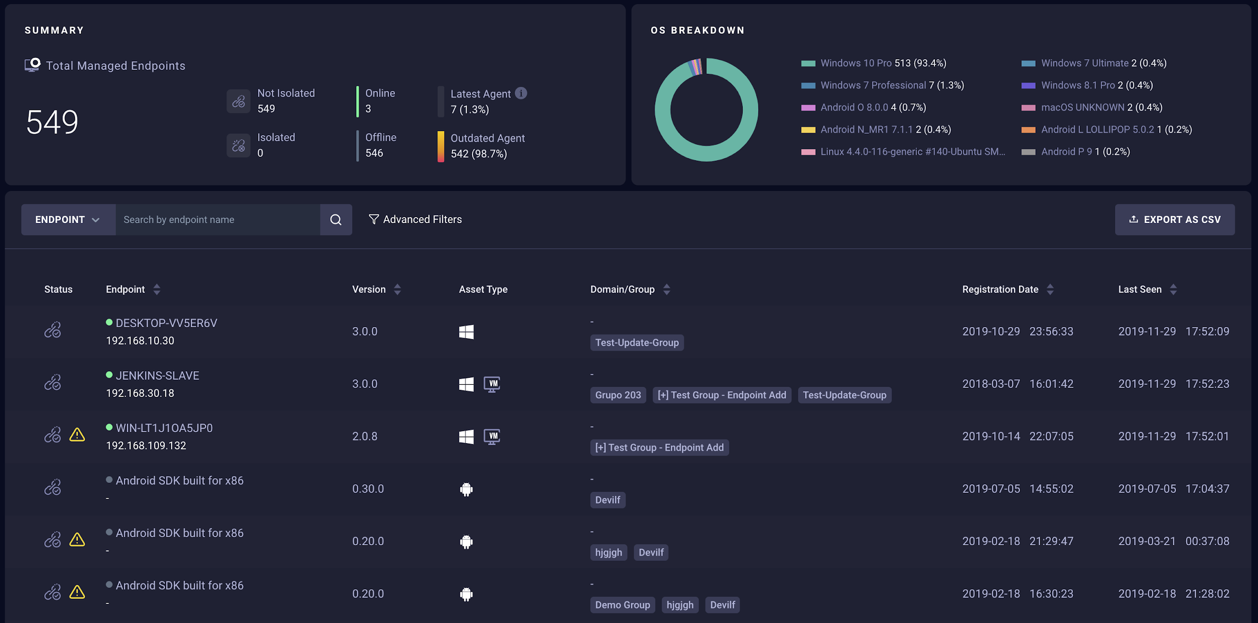
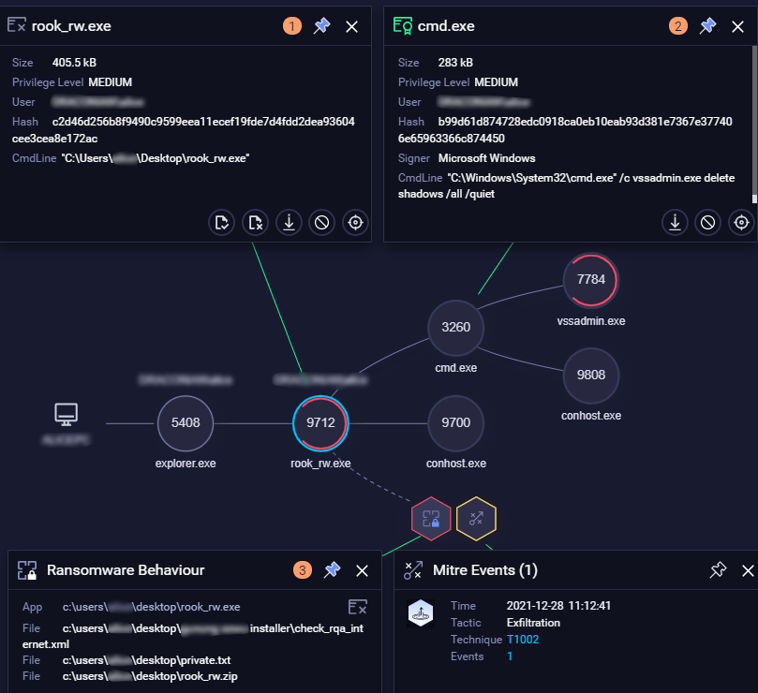

By leveraging AI and automation directly on the endpoint, ReaQta helps detect ransomware and generates a security alert
IBM’s Security Services force-multiplies ReaQta’s native AI and automation capabilities and provides an expanded evaluation of the alert, above and beyond native policies
IBM Managed Security Services Platform
ReaQta
alert telemetry
ReaQta
console
AI detection & dispositioning
Automated Response
24x7 Threat Detection & Investigation
Intelligent Orchestration
X-Force Threat Intel
Console & Sensor Management
MSS Analyst
(Critical / Sev 1))
Client Analyst
IBM’s Security Services Platform performs additional analysis on the security alert, enriching and classifying the alert as critical. MDR responders take action on the alert and quarantine the endpoint
Essential MDR customers will see enriched alert and response messages in their console.
8

Slide 9

Why choose IBM and Essential MDR for ReaQta?
Our world-class X-Force threat intelligence combines organic threat intel with machine learning analytics to speed detection and response.
Our IBM SOC delivers deep visibility and acts as an extension of your team by delivering operational transparency and collaboration.
Intrusion containment done by automation and certified security professionals.
Zero business impact or downtime

Slide 10
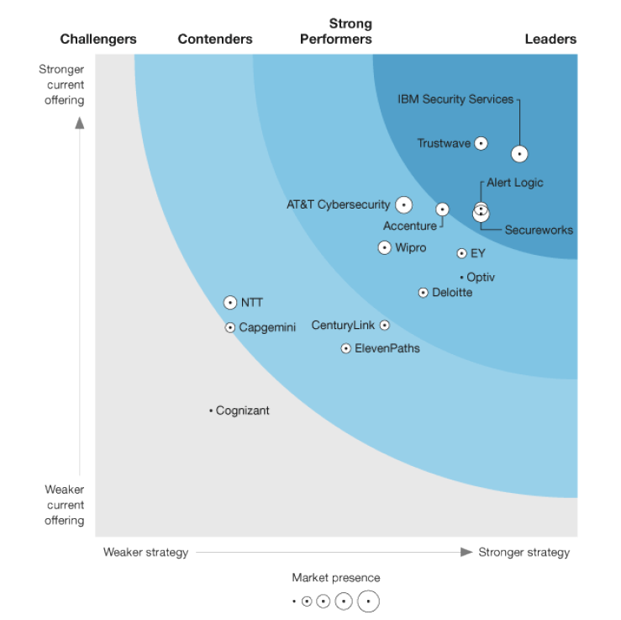
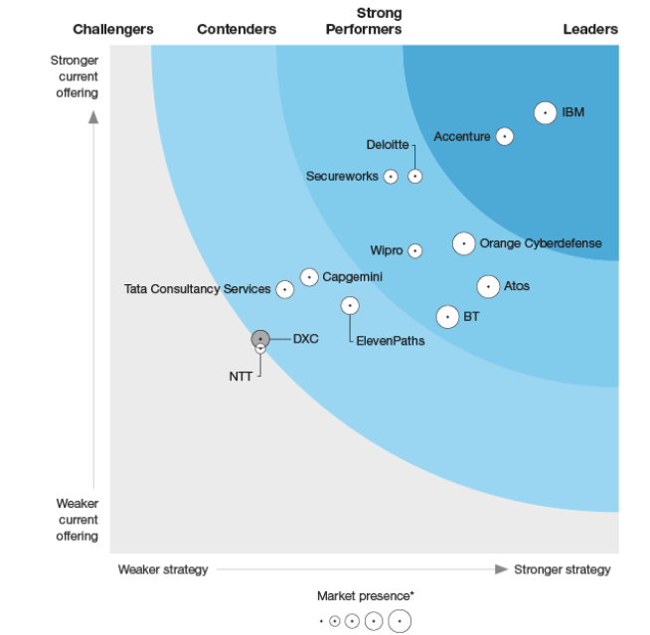
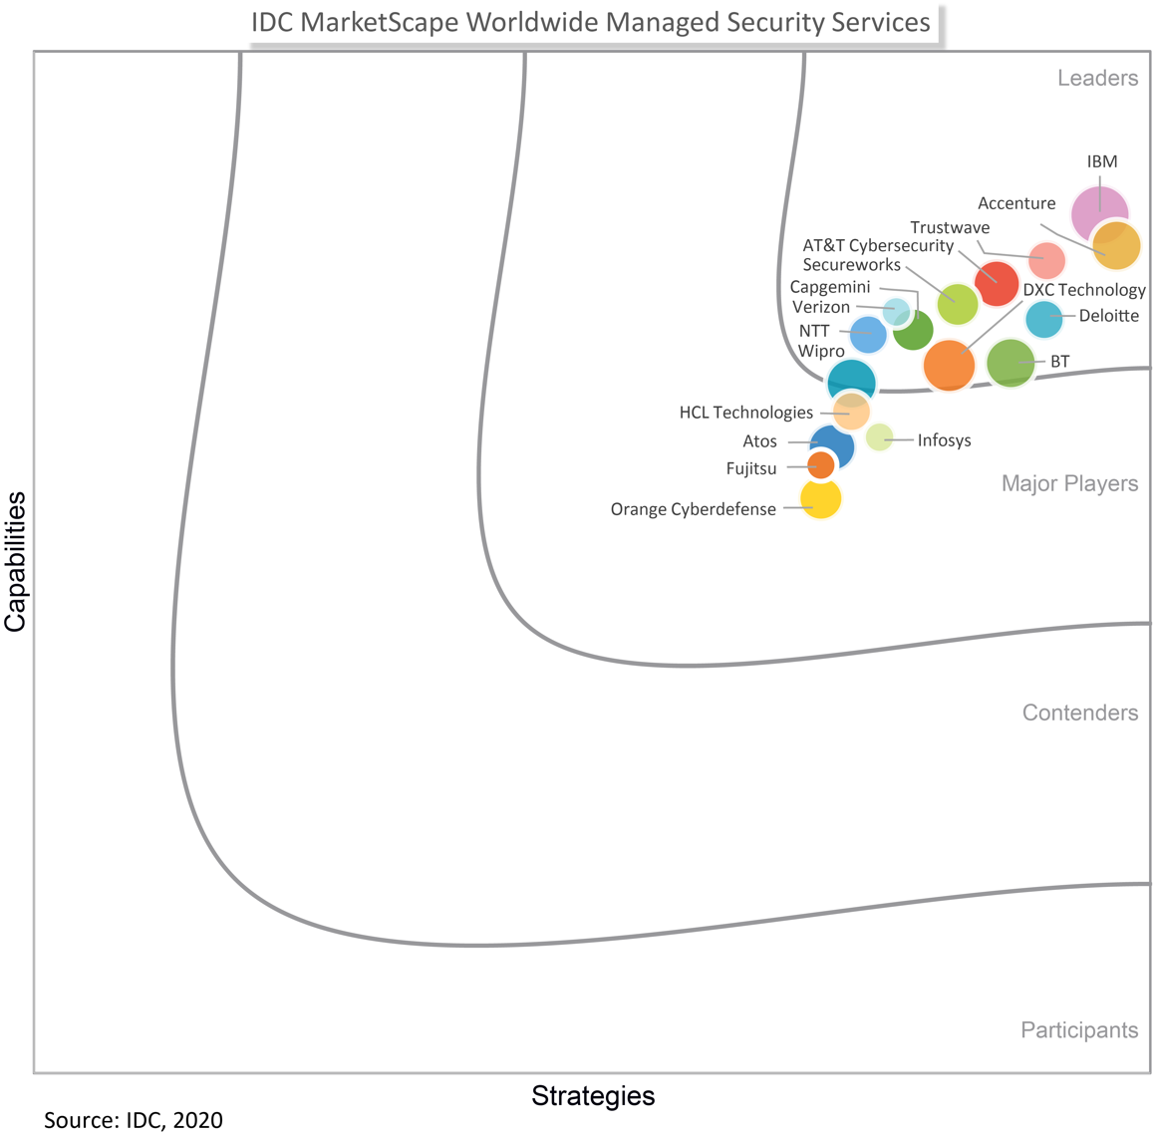
IBM is the market leader in MSS
The Forrester Wave™: Global MSSPs, 2020
Unmatched expertise
  Access to a global network of recognized security experts
  Deep industry service delivery experience across numerous types of operations
  Ability to lead and execute large, transformational projects
Integrated approach
  Integrated portfolio
  of security services
  and technology
  Open ecosystem with 100+ technology partners and 30+ services partners
  1000+ technical vendor and 150+ professional security certifications
The Forrester Wave™: EU MSSPs, 2020
IDC MarketScape: WW Managed Security Services
Best-in-class MSS
  IBM X-Force® Exchange and Threat Research teams providing zero-day threat alerts to clients
  2700+ employees
  serving 130+ countries,
  with a 95% retention rate
  4.7T security events analyzed monthly across 4,500+ global clients
Get started today
Request a demo to see how ReaQta Essential MDR can help your security team and protect your business.
Notes:
We’ve made tremendous strides to become the LEADER in the MSS market
Independent analyst validated our depth and breadth in capability of Resilient, QRadar, Watson, AI, ML
With the latest Sept 2020 report from IDC, we have even better coverage than the two Forrester Wave reports and even more coverage on the capabilities and differentiators of our managed service offerings
A strategic partner –IBM is one of the only providers to offer global coverage with localized support for compliance and regulations
This second point really highlights our breadth of coverage – from cloud migrations, application security threat intel, and threat management
IBM helps clients with a prescriptive and integrated set of expertise and tools to build a more mature and resilient threat management program
And we had some coverage around our advanced AI and ML capabilities that help our team detect and respond to threats even faster for our clients
Would you like to see a demo?

