Slide 1

IBM X-Force Exchange Threat Intelligence
Level 2 seller presentation
—
Leslie Horacek
Product Manager X-Force Platform horacek@be.Ibm.com
Jas Johal
WW security portfolio sales enablement johal@us.Ibm.com
Notes:
This Level 2 X-Force Exchange Threat Intelligence seller presentation provides an overview of the X-Force Threat Intelligence product-only portfolio, aiding the learner in understanding the Software as a Service (SaaS) offerings, exploring key case studies to understand how the IBM solution addresses client pain points, and how X-Force complements IBM QRadar and IBM QRadar XDR threat management portfolio offerings.
Contact Jas Johal at (johal@us.ibm.com) with any questions about this material.
_______________
Definitions:
XDR: eXtended Detection and Response
TI – Threat Intelligence
TII – Threat Intelligence Investigator
QRAW – QRadar Advisor with Watson
EDR: Endpoint Detection and Response
NDR: Network Detection and Response
SIEM: Security Information and Event Management
SOAR: Security Orchestration, Automation, and Response
SaaS: Software as a Service
AI: Artificial Intelligence
DNS: Domain Name Service
IRIS: Incident Response Service
IR: Incident Response
VM: Vulnerability Management
DGA: Domain Generation Algorithms
TTPs: Tactics, Techniques, and Procedures
IOCs: Indicators of Compromise
OT: Operational Technology
IoT: Internet of Things

Slide 2
Agenda
  Current threat landscape
  Cybersecurity worldwide market opportunity
  User personas
  Data sources and how IBM creates valuable cyber intelligence
  Case study
  IBM solutions to address today’s client security challenges
XForce Threat Intelligence Seller Enablement Course
Notes:
Here is the agenda for this XForce threat intelligence seller enablement. First, we will look at some interesting XForce threat intelligence report statistics. Worldwide cybersecurity market and overall IBM addressable market opportunity. Then we will talk about personas and their pain points. Next, we will examine case studies to understand the client’s business challenges. And how IBM solutions address client challenges.

Slide 3
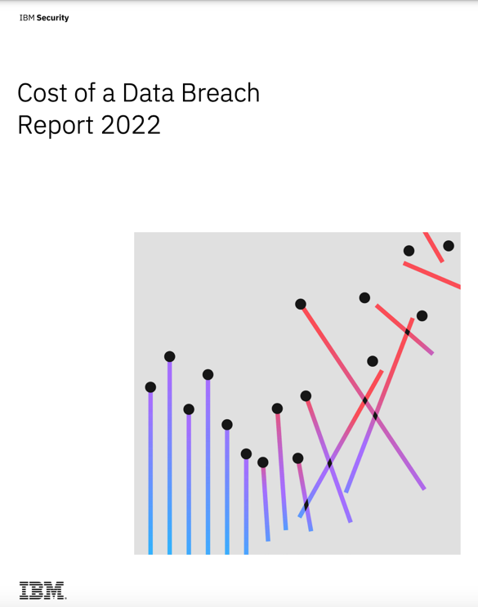
Lets first talk about findings from recent X-Force reports
Ransomware attacks were more expensive than
the average breach, and more common in 2022
41%
increase in percentage of breaches that were ransomware from 2021-2022
Notes:
Ransomware was again the top attack type in 2021.This is a great slide to kickoff here as we have discussed more on X-Force findings in the client presentation. Every size & type of client is likely experiencing these pain points right now. To point out that not only are ransomware and data attacks growing the fastest, but they are also the most profitable for cyber criminals, averaging tens of millions of dollars of profit between ransoms paid and the value of stolen data, which occurs in 13% of ransomware attacks.
At the same time, “classic” attacks like Distributed Denial of Attack (DDOS), phishing, and classic malware like Advanced Persistent Threats continue to plague businesses large and small.
IBM X-Force research revealed that Microsoft, Apple and Google were the top three brands criminals attempted to mimic. These mega brands were used repeatedly in phishing kits, with attackers likely seeking to capitalize on their popularity and the trust many consumers place in them.
Source:
X-Force Threat Intelligence index 2022: https://www.ibm.com/reports/data-breach

Slide 4
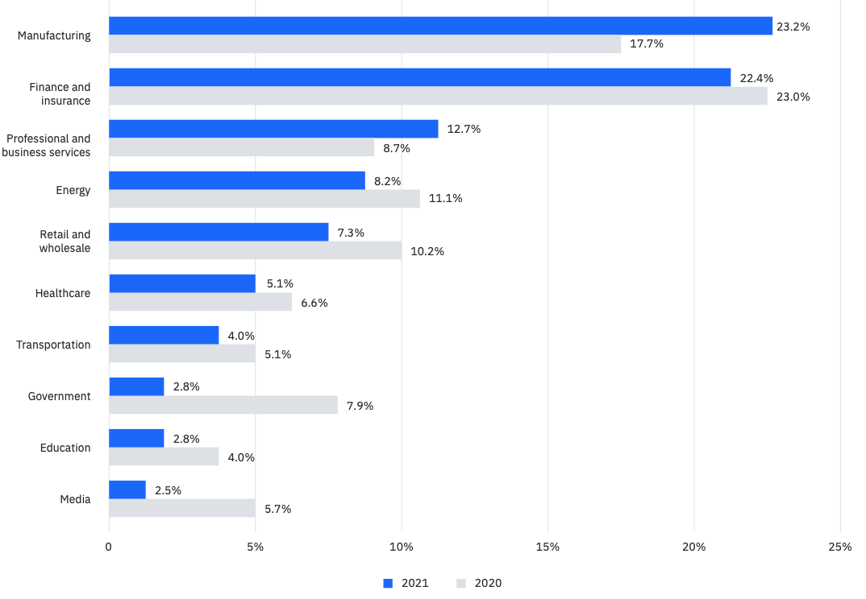
Threat actors shifting attack focus from finance and insurance to other industries
#1
Manufacturing industry rank for attacks
Notes:
Stop and think for a moment about what this slide is saying—sellers can notice that every type of company is affected. No organization is immune to cyber attacks. Cybersecurity and digitalization-related risks have been prominent for several years, but many digital transformation risks remain under mitigated. For the first time, manufacturing took over the title of being the top attacked industry from finance & insurance.
Cybersecurity is also becoming very critical in the manufacturing space as industrial IoT merges the IT environment with the OT environment connecting more and more the physical machine or objects into the connected ecosystem.
Supply chain security was pushed to the forefront of government and policymakers’ attention, with the Biden administration’s executive order on cybersecurity, and guidance from the U.S. Department of Homeland Security, CISA, and NIST doubling down on zero trust guidance.
Vulnerability exploitation was the top initial attack vector in manufacturing, an industry grappling with the effects of supply chain pressures and delays. A notional cybersecurity landscape spans around bad actor pushing malware to end user through network infrastructure usually breaching firewall or proxies.
All sellers should be very familiar with the data contained in the X-Force Threat Intelligence Index report, which can be used to discuss statistics for a specific opportunity being worked on for any of IBM Security products. A link to the recent report can be found in the speaker notes.
Notes:
X-Force Threat Intelligence Index report: https://www.ibm.com/downloads/cas/ADLMYLAZ
NIST: National Institute of Standards and Technology at the U.S. Department of Commerce
CISA: Cybersecurity and Infrastructure Security Agency
OT: Operational Technology
IoT: Internet of Things

Slide 5
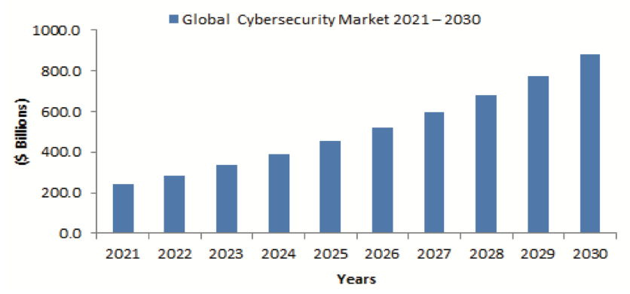
Global cybersecurity addressable market
CAGR 2021-2026 is 15.4%
Virtually every industry vertical presents a key opportunity for cybersecurity
Notes:
Well as we learned every vertical is target for cyber criminals. So here comes an opportunity for us. Per recent Mind Commerce report, Enterprise and government spending for cybersecurity products, managed services, and professional services will be substantial over the course of the next few years. Global spending on cybersecurity products and services will reach $881.6 billion in 2030. Client’s spending is driven by the realization of increasingly more voluminous and sophisticated global threats to digital infrastructure.
Source:
Mind Commerce: https://ibm.northernlight.com/document.php?docid=IA20220330440000020&datasource=IBM&trans=view&caller=resultslist
X-Force Threat Intelligence Index report: https://www.ibm.com/downloads/cas/ADLMYLAZ

Slide 6
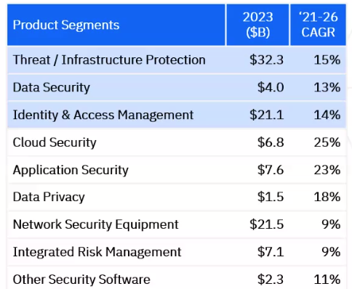
Total worldwide security opportunity
IIBM Addressable
Threat and infrastructure protection is #1 segment
(Source: Gartner)
Notes:
In the earlier slide, we discussed broader addressable opportunities. This presents us with big global cybersecurity addressable market and opportunity for IBM to help its clients. Per Gartner, every product segment presents an opportunity, and some segments show aggressive growth. We believe IBM's addressable market is in these three key segments, as highlighted, Threat and infrastructure protection, data security, and Identity & Access management.

Slide 7



X-Force Threat Intelligence user personas
SOC Analyst
Responsible for investigating security incidents
Threat Analyst
Responsible for searching IOCs in the environment
Understand X-Force Threat Intelligence user needs and create value that satisfies them
Notes:
We learned about the worldwide market and IBM's opportunity for key segments. We all acknowledge that threat intelligence has been around for over a decade. One can argue there is nothing flashy about it. Now start to think differently about threat intelligence. Today, no company can operate without robust cybersecurity. While companies dedicate resources to responding to possible cyber threats, their cyberteams are overburdened by spending valuable time researching threats that have passed rather than concentrating on real-time prevention.
Our job is to keep reminding the client how useful we are to assisting SOC to operate more productively. No matter what SIEM, SOAR, etc., products clients use for threat management. Let's look at user personas who will benefit from XForce threat intelligence. The most common SOC Analyst pain point is too many alerts resulting in alert fatigue, reducing productivity, slowing response times, and creating staff burn-out. Threat intelligence creates value that satisfies the preliminary and vital needs of SOC Analysts and Threat Analysts.
Notes:
SOC: Security Operations Center (The function of the security operations center (SOC) is to monitor, prevent, detect, investigate, and respond to cyber threats around the clock)
IOC: Indicator of Compromise (Indicators of compromise (IOCs) serve as forensic evidence of potential intrusions on a host system or network. These artifacts enable information security professionals and system administrators to detect intrusion attempts or other malicious activities)
SIEM: Security Information and Event Management
SOAR: Security Orchestration, Automation, and Response

Slide 8

IBM X-Force Exchange is a threat intelligence sharing platform
Research
Investigate security incidents with curated content spanning 2PB+ of threat intelligence.
Collaborate
Validate threats and develop response plans with peers in both public and private settings.
Act
Integrate threat intelligence with security solutions through open standards to support threat research, hunting and real-time blocking.
100K+ registered users…and counting!
Notes:
Organizations use threat intelligence, artificial intelligence (AI), and automation to detect and contain a security incident. IBM has learned that Threat actors continue to experience large-scale success against targets. IBM Security X-Force Threat Intelligence platform delivers knowledge, information, and data about cybersecurity threats, and other cybersecurity-related issues. It offers aggregation of machine-generated and human-generated more than two petabytes of threat intelligence available (from X-Force Analyst and partner sources) into a single stream. It enables you to rapidly research the latest global security threats, aggregate actionable intelligence, consult experts, and collaborate with peers. Contextual, prioritized, and actionable threat intelligence to connect the dots faster. Give security analysts time back for more high-value detection and analysis work. It helps users stay ahead of emerging threats.
Notes:
AI: Artificial Intelligence (Artificial intelligence is the simulation of human intelligence processes by machines, especially computer systems)
2PB+: Two petabyte plus (A petabyte is a measure of memory or data storage capacity that is equal to 2 to the 50thpower of bytes)

Slide 9











The combination of machine and human learning intelligence allows IBM X-Force Exchange to deliver actionable intelligence
Observables and indicators are important…
Observables and Indicators
Vulnerabilities
URL / Web Filtering
IP Reputation
Web App Control
Anti-Spam
…but they are only half of the story
Actors
Campaigns
Incidents
TTPs
Higher Order Intelligence
Notes:
X-Force Threat Intelligence includes threat observables and indicators, including higher order of intelligence monitoring threat groups, threat activities, industry trends, malware analysis, and early warnings to gain better insights and prepare clients for any uncertainty. Security operations and cyber analysts mainly use threat intelligence to discover the source, cause, purpose, and technical specifications related to cybersecurity breaches or attacks on businesses.
Most organizations benefit from Threat Intel feed integration. Enterprise security teams can extend cyber threat detection capabilities, and increase the effectiveness of initial alert triage, threat hunting, or incident response.
Notes:
TTPs: Tactics, Techniques, and Procedures

Slide 10
Our Data Sources
IBM Product Telemetry
Web Crawling
(SPIDER)
Vulnera-bility Database
DGA Sinkhole
Botnet Traps
Regional Internet Registries
Open Relay Proxies
  We ingest, enrich, and correlate IBM Proprietary and open-source commodity data sources
  X-Force Threat Intelligence feeds into IBM Security.
DNS Visibility
(Quad9 and ISP1)
OSINT/3rd party TI
WhoIs
Email/ Phishing Honeypots
Cert Stream
D9
ASN
Tor Nodes
IBM Proprietary
Commodity
X-Force Infrastructure
X-Force Incident Response
Managed Security Services
Quad9
Scanning / Crawling
  13M pages / day
  SPAM / Phishing Traps
  10M messages / day
  Anti-Fraud
  visibility to 270M+ endpoints
  Vulnerability Analysis
  12+ / week
Threat actors / Groups
  8.5M+ artifacts
  Incident Response
  worldwide engagements
Dark Web
  750M+ documents
Malware
  100k+ samples / day
Endpoints
  250k+ managed
Security Devices
  22,000+ managed
Security Events
  50B+ analyzed / day
Global Visibility
  130+ countries
Query Analytics
  Billions / day
Newly Active Domains
  Millions / day
Global Presence
  150 points of presence / 88 countries
X-Force Threat Intelligence
Actionable threat information from more than 1.5 PB of telemetry data
870,000+
malicious IPs
46 billion+
categorized URLs
3,900+
web app profiles
168,000+
documented vulnerabilities
1B+
malware indicators
130+
Global partner organizations
100+
threat
groups
Notes:
As you can see on this slide, XForce threat intelligence collects threat intelligence from multiple sources. As a result, XForce generates a reliable, accurate, and frequently updated source of threat intelligence to successfully help the client stop cyber threats. You can refer XForce threat intel as gasoline for the threat management engine. IBM threat intelligence can assist clients in identifying malicious activities within the network and augments threat management capabilities to protect it.
With the continuous collection of information regarding security vulnerabilities and potential threats, IBM X-Force builds its intelligence from reliable publicly available sources and in-house research. As a result, it empowers enterprises with the latest insights to counter cyberattacks. X-Force Threat Intelligence pushes updates every 3-5 minutes, and it combines IBM Security operations telemetry, research, incident response investigations, commercial data, and open sources to aid clients in understanding emerging threats and quickly making informed decisions.
Notes:
IOCs: Indicators of compromise

Slide 11
How we work
X-Force Threat Intelligence
Purposely-built from industry experts from a wide range of backgrounds including former government intelligence analysts, SOC analysts and private industry consultants. This team’s founding principles include strict analytic rigor, correct analysis, and reproducible assessments.
X-Force Threat Intelligence uses industry best practice frameworks such as:
Diamond Model Intrusion Analysis
Lockheed Martin Cyber Kill Chain
MITRE ATT&CK
Intelligence
Lifecycle
Tracks threats in the wild
ITG – IBM Threat Group
Established threat observations of infrastructure, capabilities, processes, and objectives (including victimology)
Hive – Threat Groups in Research
Cluster of activity (Often from a single incident)
Infrastructure, capabilities, processes, and objectives may not be clearly observed.
Threats trigger consequences (loss); resulting from a person, group, or thing with capability and intent to inflict consequence
CONTROL
INFLUENCE
CAPABILITY
INTENT
LIKELIHOOD
RISK
THREAT
IMPACT
VULNERABILITY
ASSETS
CONTROLS
EXISTENCE
PROLIFERATION
Notes:
Our observations and analysis are unique and to reflect that we use our own naming convention.
This convention is organized into two major categorizations.
First IBM Threat Groups or ITG for short. These groups are based on high confidence attribution based upon observations of the infrastructure, capabilities, processes, and objectives of a group. These groups may have well-known industry names (such as ITG23 that strongly associates with the Trickbot Group) and others may have multiple industry names. Still others may be tracked slightly different based on IBM’s unique observations and analysis.
The second categorization is Hive’s.
These are a cluster of activity that often are some a single incident. Observations and analysis on these may be clear or incomplete. As we continue to track these, they may merge with other Hive’s or ITGs. Or may graduate into a unique hive itself. The figure in the upper right corner shows our iterative intelligence lifecycle.
IBM XForce research tracks threat in the wild and perform its rigor analysis using industry frameworks like Diamond model intrusion analysis, Lockheed Martin cyber kill chain, and MITRE ATT&CK. The vulnerability, Threat, and Risk Figure on the bottom right of this slide shows the relationship between risk, threat, and vulnerability.
Risk is the exposure to consequence (loss) calculated as likelihood times impact.
The threat is the trigger to consequence; resulting from a person, group, or thing with the capability and intent to inflict consequence.
Vulnerability is the path to consequence (loss); as an avenue of access, control, or influence that can inflict consequence.
Threat has been used different ways at different times. Here at IBM we define threat as a person or group with the capability and intent to impact an organization. This requires a threat to have a path (a vulnerability) to inflict that impact.
Often, we think of vulnerability as a software bug. That is limited as it may include a misconfiguration or even an unintended exposure.
Threats can be complex with different intent and objectives. Tracking those with likelihood of impact to an organization is critical. At IBM, we track those threats in the wild through original research, open source analysis, and incident response engagements.

Slide 12
Operationalize Threat Intelligence
Purpose
Audience
Relevance
Products
Strategic | Industry or Regional Threat Management Business Risk Relevance | Executive, Board of Directors, C-Suite Planning and Budget Decision Makers | “Is my org / geo / industry a target?” “What’s my threat intel strategy? | XDR Connect (CP4S) / Threat Intelligence Insights Strategic Threat Assessment
Operational | Context about threat groups Understand threat capability and activity | Incident Response & Threat Hunters SOC L2 or L3 | “Who is / how are they attacking us?” “What are their TTPs?” | XDR Connect (CP4S) / Threat Intelligence Insights X-Force Exchange Commercial Cyber Threat Intelligence Assessment
Tactical | Indicators: IP, Domain, and File Hash Vulnerabilities and Indications | SOC L1 or L2 Triage and Defenders | “Is it a known bad or a false positive” “Should I block / escalate?” | Advanced Threat Protection Feed X-Force Exchange Commercial Dark Web Analysis Service
Notes:
IBM client needs vary depending upon their industry and cyber security organization maturity. IBM XForce offerings are designed with client requirements and audience in mind. To serve all IBM clients, you can see on this slide's far right column our solutions are packaged based on the audience's needs. For example, we have a set of products for executives who are more concerned about their business risk and brand. We have another set of products for mature client security organizations interested in knowing about adversaries and interested in Tactics, Techniques, and Procedures (TTPs). And we also offer products for the daily SOC warrior's audience, client Level 1 and Level 2 analysts who triage threats to protect the client environment from bad actors.
Notes:
TTPs: Tactics, Techniques, and Procedures
SOC: Security Operations Center

Slide 13

Case Study
IBM X-Force works with city of Los Angeles to combat cybercrime
Business problem
The client was looking to partner with a leader that could design, build, deliver and operate a cyber threat platform, which provides accurate and up-to-the minute cyber threat data from both common and unique sources.
Solution
XF IR partnered with enterprise intelligence management provider, TruSTAR to deliver a cloud-architected solution
on AWS.
The outcome is a platform that correlates key information with the associated threat group and the latest attack campaign, so businesses can determine their level of risk.
.
Notes:
Our collaboration leverages IBM Premier Threat Intelligence and Enterprise Intelligence Management with TruSTAR to make it easy for organizations to share threat information. Local businesses in Los Angeles can now share threat intelligence and use this information to improve their cyber defense.
Notes:
Los Angeles partners with IBM Security to create first-of-its-kind cyberthreat sharing group: https://www.ibm.com/campaign/government-la-cyber-lab

Slide 14
Case Study
IBM X-Force helps Centripetal operationalize threat intelligence to act against cyberthreats in real time
Business Challenge
Adapting in real time to an ever-changing cyberthreat landscape is a challenge that requires the proactive use
of vast amounts of dynamic threat intelligence.
Transformation
Centripetal Networks Inc. uses the IBM Security X-Force Exchange Commercial API solution to feed millions of threat indicators into its CleanINTERNET service, which shields against malicious attacks bi-directionally in real time.
Notes:
Centripetal created its CleanINTERNET service to protect against network infiltration and data exfiltration by cybercriminals. It taps into live feeds of critical cyberthreat intelligence, including the high-confidence IBM Security X-Force Exchange Commercial Application Programming Interface (API) solution, to shield against the highest-risk threats in real time.
Notes:
Centripetal Networks Inc.: https://www.ibm.com/case-studies/centripetal-networks-x-force-security
API: Application Programming Interface: https://www.ibm.com/products/xforce-exchange

Slide 15

Problem
Iranian hackers infiltrated a global airline stealing sensitive client data.
Client was in a continual state of incident with little endpoint visibility.
IR was handled internally with little success. XF IR for help.
Client Scenario
Solution
Incident Response at Airline #1 created
Threat Intelligence to help Airline #2
Notes:
This client scenario shows how XF Incident Response (IR) helped Airline #2 get ahead of industry targeted malware based on previous intelligence which was collected from Airline #1. However, if Airline #2 was using XF Intelligence, they could have avoided the incident.
Notes:
XF: X-Force
IR: Incident Response

Slide 16
X-Force Threat Intelligence Product Content
Advanced Threat Protection Feed
Domain Early Warning
Higher fidelity block list
Delivered API Only
Premier Threat Intelligence Subscription
Malware Analysis
Threat Group Profiles
Threat Activity Updates
X-Force Threat Intelligence focuses on delivering actionable threat intelligence for integration into existing solutions and tools for detection and protection.
  Ready for integration using API, STIX format, and TAXII connectivity
  X-Force Exchange Portal and RSS available
X-Force Exchange Commercial & Enterprise
Includes Premier Threat Intelligence
Comprehensive CVE database
Full content, indicators and rules for any X-Force Threat Intelligence report
Notes:
Gain global threat intelligence through reports with contextual information curated by the IBM X-Force team. Reports are published as content for X-Force Threat Intelligence premium subscribers.
There are five types of premium reports:
Threat Activity reports provide real-time updates about discovered activity - whether from incident response investigation, IBM telemetry, open sources, or other collection forms. As a result, security analysts can immediately understand what we know about the attack lifecycle. Likewise, executives can quickly understand the latest threats to their industry.
Early Warning Research reports providing a security analyst with early warning on malicious domains that are surfaced through X-Force's partnership with Quad9. The research includes access to threats, malicious domains, DNS activity, and volumetrics to identify abnormal spikes in activity.
Malware Analysis reports provide a security analyst with an in-depth description of how the malware functions, indicators of compromise, payloads, mutexes, and processes. The analyst can use the information to hunt on their network and pivot to other relevant information about the threat groups using the malware, similar tools, and behaviors to detect on their networks.
Threat Group profiles provide a security analyst with the latest information about cyber threat groups, including their typical targets, history, TTPs (Tactics, Techniques, and Procedures), common attack vectors, top malware, and where the threat group might be targeting next.
An Industry Analysis report provides executives with a baseline of threats to their industry and the future landscape to assess risks and assign resources based on what we observe in activity, such as relevant malware, threat groups, and threat activity.
Notes:
TTPs: Tactics, Techniques, and Procedures
API: Application Programming Interface
STIX: Trusted Automated eXchange of Intelligence Information
TAXII: Trusted Automated eXchange of Intelligence Information
https://www.ibm.com/products/xforce-exchange/editions

Slide 17
Boxes (4 tall)
Enterprise Intelligence Management
  Native 3rd party software integration
    Analyst1
    MISP
    TruStar
  Just Turn On X-Force Threat Intelligence
  X-Force Threat Intelligence MISP instance available for direct MISP connectivity
X-Force Exchange
  Threat Intelligence Portal
  Everything in the portal is accessible via API
  Included with X-Force Exchange Commercial & Enterprise Product Content
  Defined Threat Policy Categories
  Trial Available
X-Force Threat Intelligence Product Software
  Integrate X-Force Threat Intelligence Product Content via API
  Use X-Force Threat Intelligence in the QRadar Threat Intelligence App
XDR Connect
  Threat Intelligence Insights Advanced
  XDR Connect requires Red Hat Open Shift (on-prem) and is separate platform license from XF Exchange.
  Connect security data, tools and workflows
  Am I Affected / Threat Risk Scoring
Notes:
Let’s now look at the XForce Threat Intelligence software availability. You can access content via API or the XForce Exchange Portal. X-Force Threat Intelligence focuses on delivering actionable threat intelligence for integration into existing solutions and tools for detection and protection.
Enterprise Intelligence Management offers native third-party integrations. For example, MISP integration allows the creation of an event from an incident in SOAR. For artifacts that have a hit in MISP platform, one can create a sighting back to MISP to show threat intelligence teams the indicator has been seen in the wild.
XDR Connect provides XForce Threat Intelligence Application which pulls in threat intelligence feeds by using the open standard STIX and TAXII formats and to deploy the data to create custom rules for correlation, searching, and reporting. For example, you can use the app to import public collections of dangerous IP addresses from IBM X-Force Exchange and create a rule to raise the magnitude of any offense that includes IP addresses from that watch list.
Notes:
MISP: Threat intelligence platform for sharing, storing and correlating Indicators of Compromise of targeted attacks, threat intelligence, financial fraud information, vulnerability information, etc.
API: Application Programming Interface
SOAR: Security Orchestration, Automation, and Response
STIX: Trusted Automated eXchange of Intelligence Information
TAXII: Trusted Automated eXchange of Intelligence Information

Slide 18
X-Force Threat Intelligence Product Services
Strategic Threat Assessment
Examine threat attackers likely to target your organization, including their infection vectors, techniques and procedures.
Malware Reverse Engineering
In-depth description of how the malware functions, indicators of compromise, payloads, mutexes, and processes.
Dark Web Analysis Service
Continuous monitoring of your digital risks
Incorporates both internal and third-party data sources specifically focused on discovering, indexing and tracking operators, malware and data on surface, deep and dark web sites.
Cyber Threat Intelligence Assessment & Workshop
Accelerate the capabilities of your cyber threat intelligence operations and threat information dissemination policies.
Through an assessment or a training workshop, clients receive hands on coaching to align with industry best practices and improve your threat intel posture.
Notes:
XForce Threat Intelligence services offer various consulting engagements based on client needs.
Dark web analysis service provides continuous monitoring of your client risks. Other consulting engagements include strategic threat assessment and workshops to assist the client in improving threat intel posture, preparing for possible threats, and establishing best practices aligned with the client industry.

Slide 19
Advanced Threat Protection Feed by X-Force includes
IBM identifies malicious domains on an average of
DNS Early Warning
Command and Control / Botnet (C2)
Malware
Top Traffic Domains
Threat Policy Categories
8
Days earlier than its competitors
X-Force Feeds (lists) are available in industry standard formats: STIX/TAXII, JSON, CSV and plain text
10k Indicators updated every hour
Notes:
Let’s review details with the key message to convey the value of XForce offerings. Advanced Threat Protection X-Force Feeds (lists) are available in industry standard formats: STIX/TAXII, JSON, CSV, and plain text and include:
DNS Early Warning: Early warning on potentially malicious domains surfaced daily through IBM’s collaboration with Quad9. IBM identifies malicious domain on average if eight days earlier than its competition.
Command and Control / Botnet (C2: High-Risk Botnet command and control servers IP, BOT’s IP, and Phishing URLs)
Malware: High Risk IP and URL’s associated with all malware
Top Traffic Domains: Reputation of highest volume sites as observed by X-Force
Threat Policy Categories: Anonymization Services, Crypto–Currency Miners, Scanning IP’s
The Advanced Threat Protection Feed by X-Force is focused on delivering actionable threat intelligence for integration into existing solutions and tools for detection and protection. About 10,000 indicators are updated every hour, and on average, it has been able to identify malicious domains eight days earlier than its competitors who are providing similar threat intelligence capabilities. IBM X-Force Exchange Threat Intelligence helps improve operations efforts like an incident response (IR), threat
hunting and vulnerability management (VM). It helps:
Avoid fatigue from false positives
Take immediate action
Block or audit known threats
Notes:
STIX/TAXII:Structured Threat Information Expression/Trusted Automated eXchange of Indicator Information
JSON: JavaScript Object Notation
CSV: Comma-separated values
DNS: Domain Name System
IP: Internet Protocol
URL: Uniform Resource Locators

Slide 20



DNS Early Warning:
Malicious domains blocked
Malicious DNS requests are blocked by Quad9¹ on average, every day
Early Warning Feed
60
Million
Deep-dive lifecycles
Actionable intelligence
Notes:
Early warnings on potentially malicious domains surfaced daily through IBM’s collaboration with Quad9. Quad9 is an open recursive DNS service that blocks hosts containing malware, phishing, botnets, spyware, and various other risks that try to defraud end-users or harm their computers or networks. On average, sixty million malicious domain name service (DNS) requests are blocked by Quad9.
The Early Warning Feed empowers security analysts to act against undergoing/upcoming attacks faster by providing early warning on hundreds of new malicious domains surfacing daily through IBM’s collaboration with Quad9 and the use of X-Force DNS Analytics. Deep-dive lifecycles on these domains and volumetric data on their activity provide timely, actionable intelligence that helps analysts protect against DNS attacks such as phishing, squatting, and domain generation algorithms (DGA).
Notes:
DNS: Domain Name System
DGA: Domain Generation Algorithm
¹ Quad9.net “Quad9 Sees Massive Growth in Blocked DNS Volume”, March 2020: https://www.quad9.net/news/blog/quad9-sees-massive-growth-in-blocked-dns-volume/

Slide 21

Need for speed in response and containment
INCOMPLETE
USD 1.12 million
savings in average breach costs when the breach was contained in under
200 days
Notes:
The statistics on this slide are great information to share with clients and discuss how IBM Security solutions can bring agility and significant savings in threat detection and management. There is a need to quickly detect and contain breaches, with global threat intelligence and containment and response technologies.
Organizations using security artificial intelligence (AI) and automation detected and contained an incident on average 74 days faster versus organizations that didn’t deploy security AI and automation
Breaches at organizations with AI and automation tools cost USD 3.05 million less than those with no AI and automation deployed
Organizations with extended detection and response (XDR) technologies
identified and contained a breach on average 29 days faster than organizations
without XDR technologies
Hybrid cloud adopters were able to identify and contain a data breach in 15 days less than the global average and eight days less than private cloud adopters
Average breach cost savings associated with an incident response (IR) team and regularly tested IR plan was USD 2.66 million, compared to no IR team or IR testing
Zero trust deployed led to an average of USD 1 million in lower breach costs than those without zero trust deployed
Also point out that healthcare, supply chain, manufacturing and energy are among the top targets (number 7, 2, and 3 of the top 10 respectively). All sellers should be very familiar with the data contained in the X-Force Threat Intelligence Index report, which can be used to find statistics for a specific opportunity being worked on. A link to the report can be found in the speaker notes.
Supply chain security was pushed to the forefront of government and policymakers’ attention, with the Biden administration’s executive order on cybersecurity, and guidance from the U.S. Department of Homeland Security, CISA, and NIST doubling down on zero trust guidance. Vulnerability exploitation was the top initial attack vector in manufacturing, an industry grappling with the effects of supply chain pressures and delays.
Notes:
NIST: National Institute of Standards and Technology
CISA: Cybersecurity and Infrastructure Security Agency
XDR: Extended detection and response

Slide 22





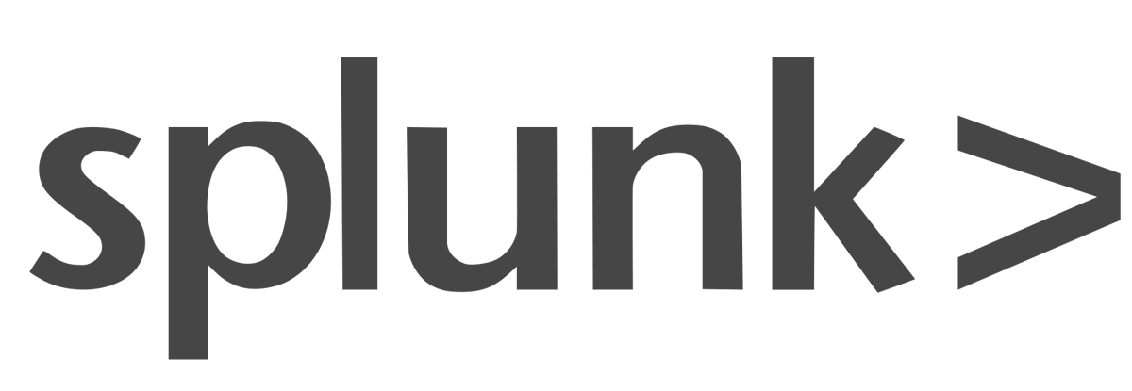











IBM Security QRadar XDR, an open, connected approach
IBM Security QRadar XDR
EDR
SIEM
NDR
XDR Connect
SOAR
Threat Intel
IBM Security
QRadar SIEM
IBM Security
QRadar NDR
IBM Security
QRadar XDR Connect
IBM Security
QRadar SOAR
IBM Security
X-Force
Identify and manage threats on the endpoint
Detect advanced threats and reduce dwell time
Catch hidden threats with network visibility and advanced analytics
Connect tools, automate your SOC, and free up time for what matters most
Respond to security incidents with confidence and automation
Gain deep security research and global threat intelligence
Cloud Pak for Security: Open Platform
Open Integrations
Connect your tools with open third-party integrations
Alien Vault
Microsoft Azure
Azure Sentinel
MySql
Notes:
IBM offers a new suite of XDR offerings under the QRadar brand. IBM QRadar XDR helps security analysts break down the silos between the proliferation of point products in the industry – providing comprehensive visibility across security tools and data sources, whether in the cloud or on-premises, and equipping security teams with the insights they need to act quickly. ReaQta offerings are now part of this portfolio, adding expanded native XDR capabilities to IBM’s security portfolio and provide:
A simple, accurate view of threats with a response recommendation and the ability to act
Out of the box, regularly updated and tuned, threat detection and response content that reflects the evolving threat landscape
Unified view of use cases and their management
Work with an ecosystem of the leading EDR, NDR and ultimately SIEM vendors
Integrated services and expertise ‘on demand’ to help with edge cases
Simple licensing that scales easily with protection level
QRadar XDR Connect is a set of extended detection and response capabilities that run on an open security platform, so clients can connect their tools. Automate their SOC. Free up time for what matters most.
Clients likely don’t rely on one company to provide all of their security needs. Different tools deliver a variety of insights, critical to detecting advanced threats. However, having too many tools and too many alerts can cause visibility issues. Open extended detection and response (XDR) can connect critical insights across their siloed tools to deliver a single workflow—infused with automation—designed to accelerate detection, investigation and response, while leaving their data where it is.
QRadar XDR Connect is a cloud-native open XDR solution that can save clients time by connecting their tools, workflows, insights, and people. IBM’s solution adapts to their team’s skills and needs, whether they have an analyst looking for streamlined visibility and automated investigations or an experienced threat hunter looking for advanced threat detection. XDR Connect empowers them to leverage the tools that work for their teams and puts time back on their side.
QRadar XDR Connect brings together a set of capabilities to help enhance, automate, and simplify extended detection and response. Delivered on an open security platform, QRadar XDR Connect helps SOC teams:
Gain enhanced insights while improving detection of threats. QRadar XDR Connect helps teams cut through the noise of too many alerts from disparate tools. By connecting additional telemetry with your data using an open security platform, QRadar XDR Connect correlates related alerts and prioritizes them for clients so their teams can detect without alert fatigue.
Act quickly by automating threat investigations and accelerate threat hunting. QRadar XDR Connect uses artificial intelligence (AI) to automate case investigation and correlate data, enabling analyst efficiency and allowing more time for strategic analysis and threat hunting. A threat timeline, MITRE ATT&CK mapping and contextual threat intelligence can help improve prioritization,
root-cause analysis and response.
Leverage your existing security tools. Clients don’t have to get rid of their existing tools and buy all new from IBM. The clients’ security teams will have the ability to connect a full range of tools, data and intelligence feeds to modernize their SOC and address the needs of their teams. Delivered on an open security platform, QRadar XDR Connect enables clients to use the security tools of their choice.
Let IBM’s team become an extension of theirs. If the client is not ready to tackle detection and response on their own, IBM’s Managed Detection and Response Services offers 24/7 managed protection, detection and response — powered by AI. IBM’s X-Force team can continuously monitor the client’s network and endpoints, provide visibility, automate response actions, hunt threats, and apply threat intelligence to help them to contain threats and recover from attacks.
IBM can simplify detection and response, and keep the client’s organization protected, being a with a leader in Security Analytics and Managed Security Services.
Notes:
XDR: Extended detection and response
EDR: Endpoint detection and response
NDR: Network detection and response
SIEM: Security information and event management
SOC: Security Operations Center

Slide 23



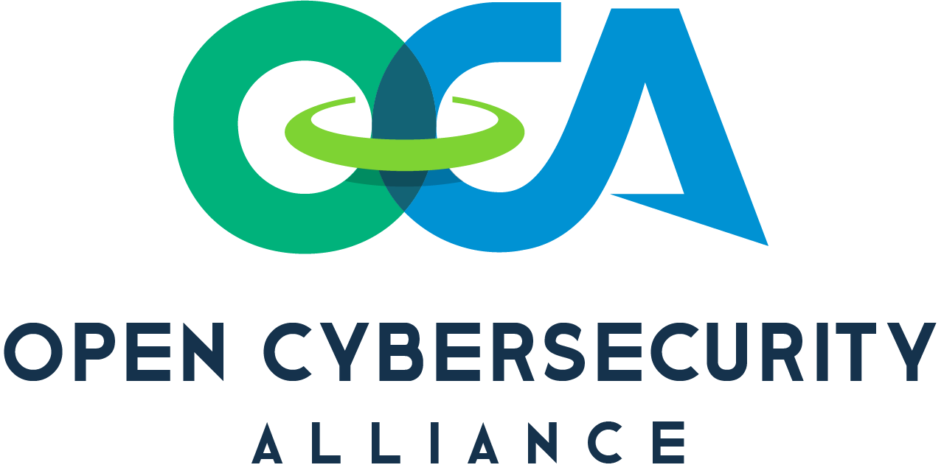

Additional IBM solutions to address today’s client security challenges
Client
Challenges
Protect data
across the
hybrid cloud
Secure remote workers and consumers
Predict, prevent, and respond to modern threats
Improve the effectiveness
of security programs
IBM Solutions
IBM Security Guardium
IBM Data and Application Security Services
IBM Security Verify
IBM Security IAM Services
IBM Security MaaS360
IBM SASE Services
Powered by IBM Technology Alliances
IBM Zero Trust Acceleration Services
QRadar XDR
X-Force Threat Management Services
X-Force Red
X-Force Incident Response Retainer
X-Force Threat Intelligence
IBM Security Cyber Range
IBM Security Consulting Services
IBM Security Expert Labs
IBM Managed Security Services
IBM Differentiation
Deep
Expertise
AI-Driven Technology
Open
Platform
Largest Ecosystem
Trusted Advisors
Command Centers
Integrated Solutions
Threat Management
Data Security
Identity and Access
Managed Services
IBM Cloud Pak
for Security
Thousands of partner integrations
750K active users
on X-Force Exchange
Notes:
This slide illustrates IBM’s X-Force Threat Intelligence and QRadar XDR offering. But we do recognize that client needs are far more than predicting threats and protection. IBM Security offers a comprehensive portfolio of leading services and products that Modernize, Align, Protect, and Manage security.
Clients can modernize your security with an open, zero trust approach
By focusing on their business needs, IBM’s Security Zero Trust approach delivers security the way it should be – comprehensive, continuous, and connected – with experts to support clients in mapping the right path for their organization. Moving to Zero Trust doesn’t mean throwing every existing security solution out and starting again. With an open platform and ecosystem, IBM can uniquely integrate new and existing tools to help implement Zero Trust Architecture and wrap security – with context – around every user, every device, every connection – every single time.
Key offerings: IBM Security Zero Trust Acceleration Services and IBM Cloud Pak for Security
Align a client’s security strategy to their business
With the industry’s leading portfolio of Cybersecurity Services, IBM Security delivers assessments and strategies to match the speed of business for many of the world’s largest enterprises. As a trusted advisor, IBM can help quantify and understand their risks, extend their team resources, protect their hybrid cloud and unify their security priorities to accelerate business transformation.
Key offerings: IBM Security Risk Quantification Services and IBM Security Services for Cloud Security Strategy
Protect digital users, assets, and data
Over 100 Million users rely on Data and Identity Protection from IBM Security to safeguard access to critical data and apps wherever they live – in the cloud, on mobile devices, or on-premises. IBM helps businesses excel by protecting assets, identity, and access across every layer of their constantly evolving hybrid multi-cloud architecture.
Key offerings: IBM Security Guardium Insights and IBM Security Verify SaaS
Manage defenses against growing threats
Only IBM Security delivers a complete and open XDR platform to manage threats across their entire lifecycle. IBM’s vendor-agnostic approach helps SOCs worldwide detect and respond to threats up to 50% faster by applying autonomous attack analytics and orchestrated responses – allowing clients to refocus resources from repetitive tasks to more valuable outcomes. IBM’s threat management services deliver advisory, fully managed and open technology solutions to enhance security operations.
Key offerings: IBM Security QRadar XDR Connect and IBM Security X-Force Threat Management
IBM’s solutions are backed by decades of investment and differentiated by IBM’s trusted security expertise that spans every industry all over the world.
Notes:
XDR: Extended Detection Response
SOC: Security Operations Center

Slide 24
IBM sign-off
Notes:
This page is self-explanatory and requires no speaker notes.

